Slide 1


Geant4 simulations of electron detection systematic errors for UCNA+
Rashika Gupta
November 30, 2023

Slide 2
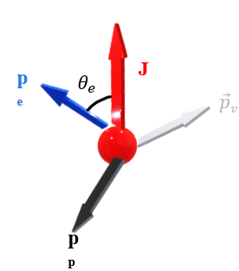
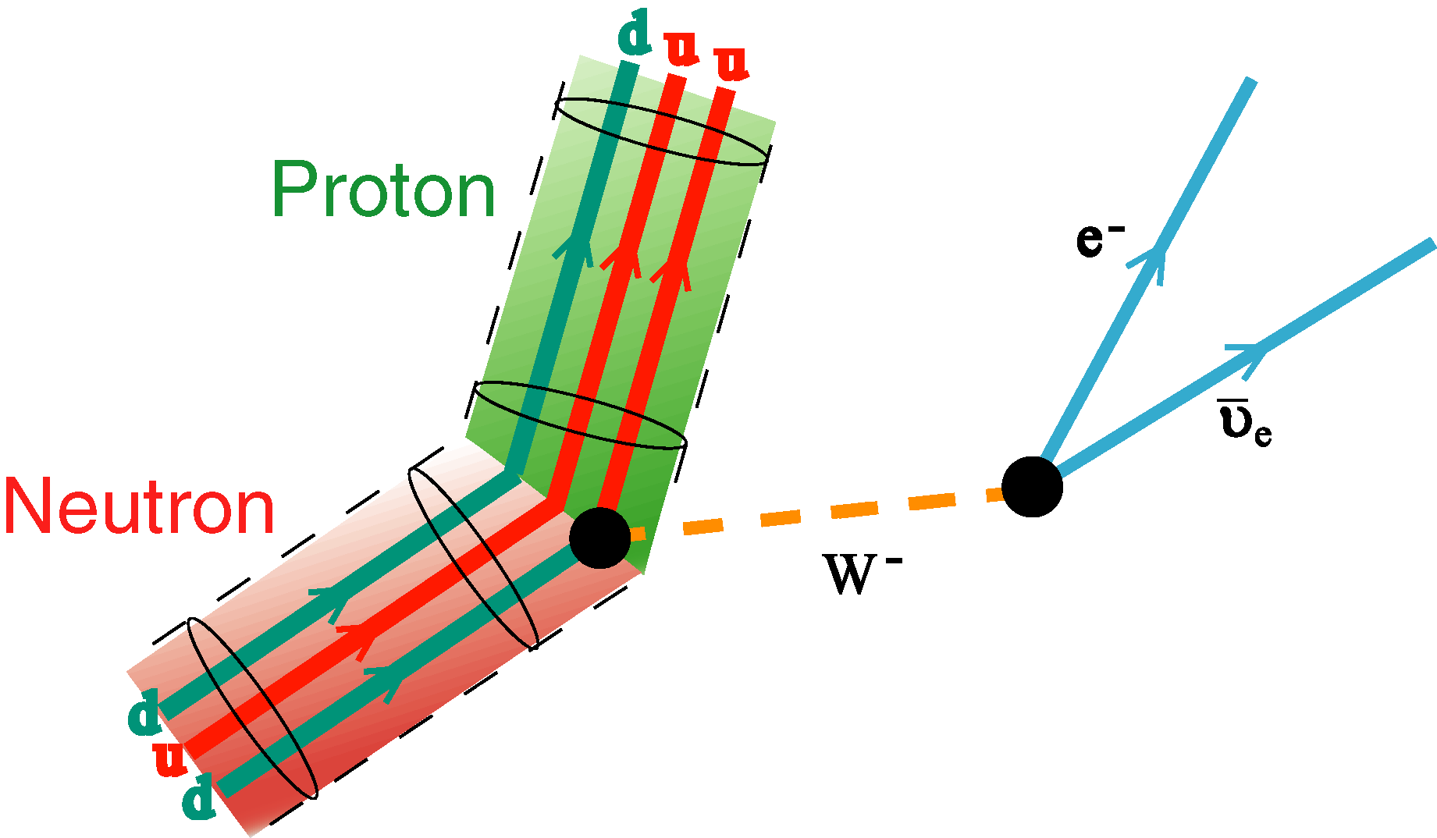
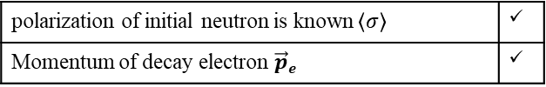
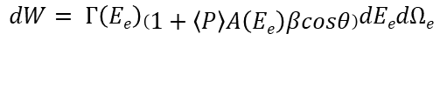
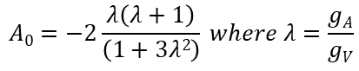
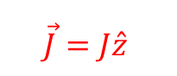
Angular Correlations
polarization of initial neutron is known $\left\langle σ\right\rangle$ | ✓
Momentum of decay electron $\vec{p}e$ | ✓
$$dW= Γ\left(Ee\right)\left(1+\left\langle P\right\rangle A\left(Ee\right)βcosθ\right)dEedΩe$$
$$\vec{J}=J\hat{z}$$
$$A0=−2\frac{λ\left(λ+1\right)}{\left(1+3λ2\right)} where λ=\frac{gA}{gV}$$
1
APS DNP 2023 R.Gupta 2

Slide 3
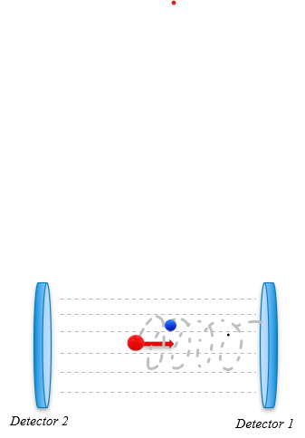
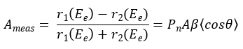
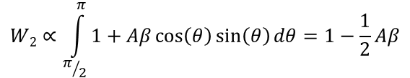
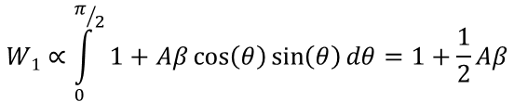
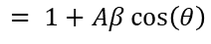
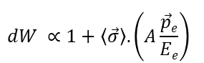
Angular Correlations
polarization of initial neutron is known $\left\langle σ\right\rangle$ | ✓
Momentum of decay electron $\vec{p}e$ | ✓
$$dW= Γ\left(Ee\right)\left(1+\left\langle P\right\rangle A\left(Ee\right)βcosθ\right)dEedΩe$$
$$\vec{J}=J\hat{z}$$
$$A0=−2\frac{λ\left(λ+1\right)}{\left(1+3λ2\right)} where λ=\frac{gA}{gV}$$
$$W1∝\int_{0}^{π/2}{1+Aβ\cos\left(θ\right)\sin\left(θ\right)dθ}=1+\frac{1}{2}Aβ$$
$$dW ∝1+\left\langle \vec{σ}\right\rangle . \left(A\frac{\vec{p}e}{Ee}\right)$$
$$W2∝\int_{π/2}^{π}{1+Aβ\cos\left(θ\right)\sin\left(θ\right)dθ}=1−\frac{1}{2}Aβ$$
Without back-scattering
$$= 1+Aβ\cos\left(θ\right)$$
1
APS DNP 2023 R.Gupta 2

Slide 4
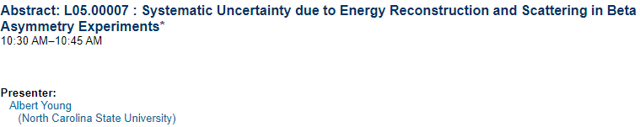
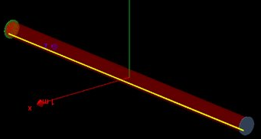
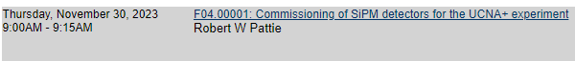

From UCNA to UCNA +
Incorporate new silicon photomultiplier plastic scintillator readout
No MWPC
• Develop new precise calibration tools
Minimize and understand backscattering precisely
- decreasing the fraction of electrons that are lost in the spectrometer
- Model different geometries
- Direct measurements
- Time of flight method
- Fractional changes in the back-scattering
Fig : Geant4 simulations representation for UCNA+ experiment
3
APS DNP 2023 R.Gupta 3
Notes:
Low probability of Compton scattering in pastic detectr

Slide 5
From UCNA to UCNA +
Incorporate new silicon photomultiplier plastic scintillator readout
• Develop new precise calibration tools
Minimize and understand backscattering precisely
- Decreasing the fraction of electrons that are lost in the spectrometer
- Model different geometries
- Direct measurements
- Time of flight method
- Fractional changes in the back-scattering
Fig : Geant4 simulations representation for UCNA+ experiment
3
APS DNP 2023 R.Gupta 3

Slide 6

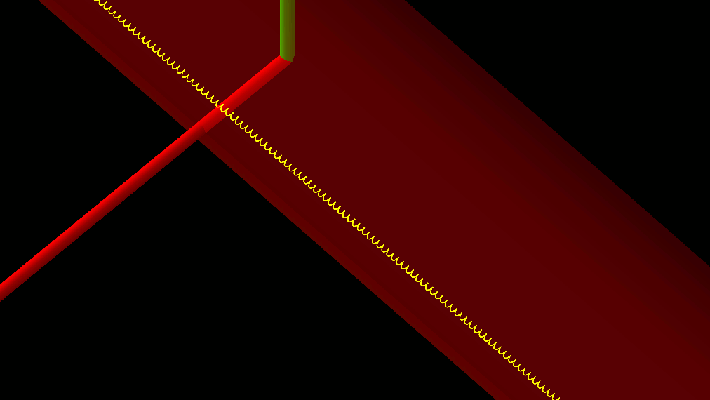

BACK-SCATTER
Direct Events ( ~ 97%)
Beta particle hits Detector 1, but scatters in the detector material, reversing direction and leaving detector
Back-scattered Events
Detector 2 (-z)
Detector 1 (+z)
Problem: to reconstruct the asymmetry,
we have to know which detector is hit first!
APS DNP 2023 R.Gupta 4

Slide 7
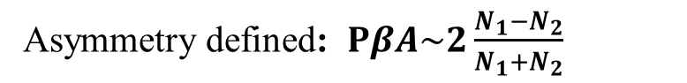
BACK-SCATTER
Beta particle hits Detector 1, but scatters in the detector material, reversing direction and leaving detector
Detector 2 (-z)
Detector 1 (+z)
To get rate difference right, need to know which detector was hit first (use timing!)
Asymmetry defined: $PβA\sim 2\frac{N_{1}−N_{2}}{N_{1}+N_{2}}$
This works if particle scatters from active detector material, and event is above detection energy threshold!
APS DNP 2023 R.Gupta 4
Notes:
Hardware – detector threshold for detetction of electrons.

Slide 8
MISSED BACK-SCATTER
Worst Case:
Beta particle hits endcap foil (dead material, no active detection), and back-scatters
Detector 2 (-z)
Detector 1 (+z)
APS DNP 2023 R.Gupta 5

Slide 9
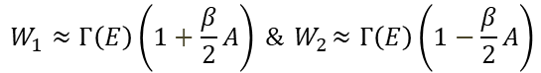
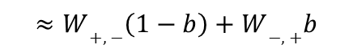
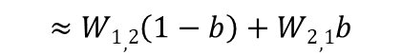
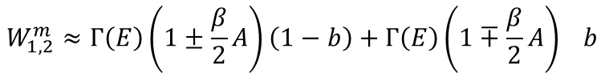
MISSED BACK-SCATTER
Worst Case:
Beta particle hits endcap foil (dead material, no active detection), and back-scatters
$$W_{1}≈Γ\left(E\right)\left(1+\frac{β}{2}A\right) \&{ W}_{2}≈Γ\left(E\right)\left(1−\frac{β}{2}A\right)$$
Detector 2 (-z)
Detector 1 (+z)
Assume a backscatter fraction b for each detector
(these will actually be different for isotropic and anisotropic angular distributions)
$$W_{1,2}^{m}≈Γ\left(E\right)\left(1±\frac{β}{2}A\right)\left(1−b\right)+{Γ\left(E\right)\left(1∓\frac{β}{2}A\right)}_{}b$$
$$≈W1,2\left(1−b\right)+W2,1b$$
$$≈W+,−\left(1−b\right)+W−,+b$$
APS DNP 2023 R.Gupta 5

Slide 10
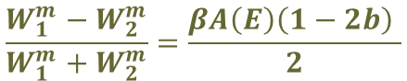
MISSED BACK-SCATTER
Worst Case:
Beta particle hits endcap foil (dead material, no active detection), and back-scatters
$$W_{1}≈Γ\left(E\right)\left(1+\frac{β}{2}A\right) \&{ W}_{2}≈Γ\left(E\right)\left(1−\frac{β}{2}A\right)$$
Detector 2 (-z)
Detector 1 (+z)
Result: washout asymmetry!
Assume a backscatter fraction b for each detector
(these will actually be different for isotropic and anisotropic angular distributions)
$$\frac{W_{1}^{m}−W_{2}^{m}}{W_{1}^{m}+W_{2}^{m}}=\frac{βA\left(E\right)\left(1−2b\right) }{2}$$
$$W_{1,2}^{m}≈Γ\left(E\right)\left(1±\frac{β}{2}A\right)\left(1−b\right)+{Γ\left(E\right)\left(1∓\frac{β}{2}A\right)}_{}b$$
$$≈W1,2\left(1−b\right)+W2,1b$$
$$≈W+,−\left(1−b\right)+W−,+b$$
APS DNP 2023 R.Gupta 5

Slide 11
MISSED BACK-SCATTER
Worst Case:
Beta particle hits endcap foil (dead material, no active detection), and back-scatters
$$W_{1}≈Γ\left(E\right)\left(1+\frac{β}{2}A\right) \&{ W}_{2}≈Γ\left(E\right)\left(1−\frac{β}{2}A\right)$$
Detector 2 (-z)
Detector 1 (+z)
Result: washout asymmetry!
Assume a backscatter fraction b for each detector
(these will actually be different for isotropic and anisotropic angular distributions)
$$\frac{W_{1}^{m}−W_{2}^{m}}{W_{1}^{m}+W_{2}^{m}}=\frac{βA\left(E\right)\left(1−2b\right) }{2}$$
$$W_{1,2}^{m}≈Γ\left(E\right)\left(1±\frac{β}{2}A\right)\left(1−b\right)+{Γ\left(E\right)\left(1∓\frac{β}{2}A\right)}_{}b$$
Can’t directly measure – strategy:
Make foils thin
Correct for dead-layers
$$≈W1,2\left(1−b\right)+W2,1b$$
$$≈W+,−\left(1−b\right)+W−,+b$$
APS DNP 2023 R.Gupta 5

Slide 12
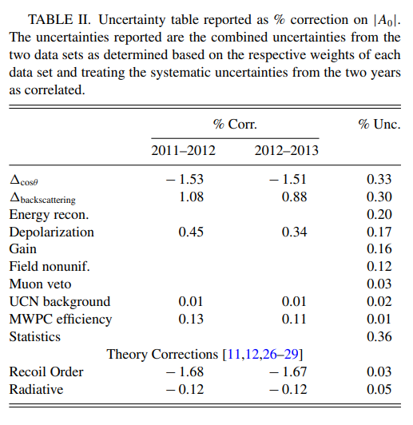
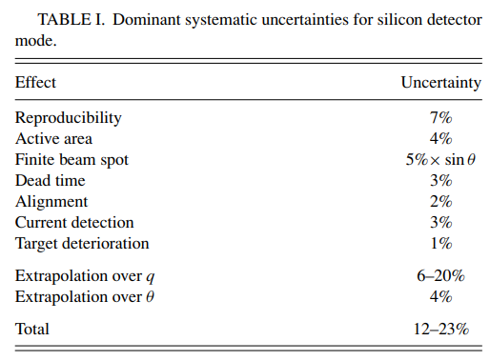
From UCNA
Source : J.W. Martin, PHYSICAL REVIEW C 73, 015501 (2006)
Source : M. Brown, PHYSICAL REVIEW C 97, 035505 (2018)
3
Previous uncertainties: took worst case, 25% uncertainty for corrections …
APS DNP 2023 R.Gupta 6
Notes:
Previous uncertainties: took worst case, 25% uncertainty for corrections …
Show UCNA, Plaster paper?
0.2 % to match the pereko III precision and which would be pretty close.
ERROR BUDGET : in UCNA there was significant back-scattering. Need to model very precisely. Aimining for below 10% for the back-scattering correction.

Slide 13
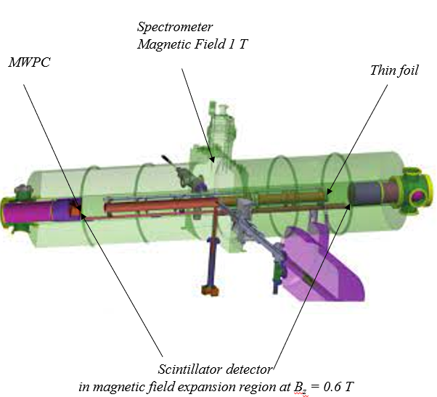
From UCNA
Fig : Schematic representation of UCNA setup
3.0 m
0.0035 m
Decay Trap
B_{z} = 1.0 T
Drift Tube
0.7 m
Thin foil
MWPC
6 µm thick Mylar
Detector
APS DNP 2023 R.Gupta 7

Slide 14
Scattering test geometry for UCNA+
3.0 m
0.0035 m
Decay Trap
B_{z} = 1.0 T
Drift Tube
0.0035 m
Fig : Schematic representation of UCNA+ base setup
0.7 m
Thin foil
Detector
Explore magnitude of scattering corrections and measure the aspects of UCNA+
APS DNP 2023 R.Gupta 7
Notes:
Two backing detectors for background subtraction

Slide 15
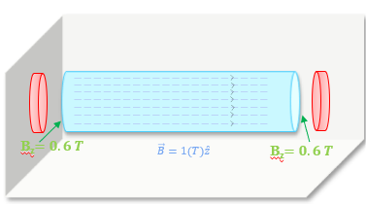
UCNA + Geant4 setup
Different configurations for scattering measurements
Endcap foils
- uniform field region
- field expansion region
Source holder foils
- Mylar of 0.5-micron thickness
- 6F-6F 0f 120 nm thickness,
- Graphite
Fig : Geant4 simulations representation for base setup of UCNA+ experiment
APS DNP 2023 R.Gupta 8

Slide 16
UCNA + Geant4 setup
Different configurations for scattering measurements
Endcap foils
- uniform field region
- field expansion region
Source holder foils
- Mylar of 0.5-micron thickness
- 6F-6F 0f 120 nm thickness,
- Graphite
Fig : Geant4 simulations representation for UCNA+ experiment with the source holder at the center made of mylar of thickness 0.5 micron.
APS DNP 2023 R.Gupta 8
Notes:
Radius is 3.5mm

Slide 17
UCNA + Geant4 setup
Different configurations for scattering measurements
Endcap foils
- uniform field region
- field expansion region
Source holder foils
- Mylar of 0.5-micron thickness
- 6F-6F 0f 120 nm thickness,
- Graphite
Fig : Geant4 simulations representation for UCNA+ experiment with the source holder at the center made of 6F6F of thickness 120nm.
APS DNP 2023 R.Gupta 8

Slide 18
UCNA + Geant4 setup
Different configurations for scattering measurements
Endcap foils
- uniform field region
- field expansion region
Source holder foils
- Mylar of 0.5-micron thickness
- 6F-6F 0f 120 nm thickness,
- Graphite
Foils :
6F6F (made of H, C, N, O, F) of 130 nm thickness
Be coating of 120 nm thickness
Bz = 0.99 T
Fig : Geant4 simulations representation for base setup of UCNA+ experiment with endcap foil in the uniform field expansion region of Bz = 0.97 T.
APS DNP 2023 R.Gupta 8

Slide 19
UCNA + Geant4 setup
Different configurations for scattering measurements
Endcap foils
- uniform field region
- field expansion region
Source holder foils
- Mylar of 0.5-micron thickness
- 6F-6F 0f 120 nm thickness,
- Graphite
Foils :
6F6F (made of H, C, N, O, F) of 130 nm thickness
Be coating of 120 nm thickness
Bz = 0.99 T
Fig : Geant4 simulations representation for base setup of UCNA+ experiment with two endcap foil in the uniform field expansion region of Bz = 0.99 T.
APS DNP 2023 R.Gupta 8

Slide 20
UCNA + Geant4 setup
Different configurations for scattering measurements
Endcap foils
- uniform field region
- field expansion region
Source holder foils
- Mylar of 0.5-micron thickness
- 6F-6F 0f 120 nm thickness,
- Graphite
Fig : Geant4 simulations representation for base setup of UCNA+ experiment with endcap foil in the uniform field expansion region of Bz = 0.6 T.
APS DNP 2023 R.Gupta 8

Slide 21
UCNA+ simulation results for backscattering systematics using 113 Sn
Geant4 Version
GOAL : establish reliable predictions on uncertainties of back-scattering changes < 10 %
Change in ratios of back-scattered events
Change in average energy deposition with time of flight
Change in Physics models and step-size in simulations
APS DNP 2023 R.Gupta 9
Notes:
Add goal : to estab
prediction of backscattering changes at the 10% level

Slide 22
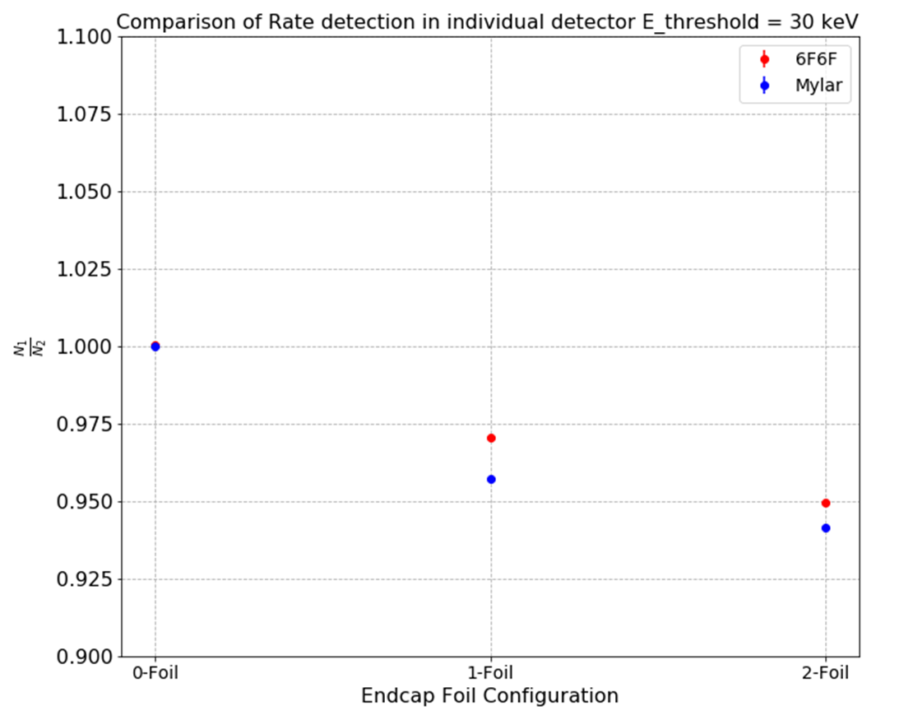
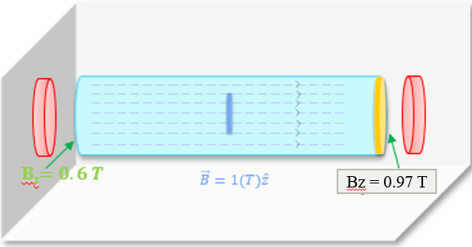
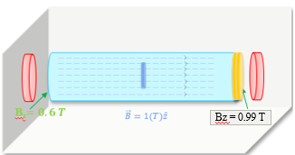
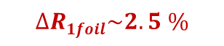
Comparison of total rate of detection
for different endcap foil configuration and different source holder
Endcap foil : 6F6F - 130 nm thick
Be coating - 120 nm thick
Source holder :
Mylar : 0.5 micron
6f6f : 120 nm
# : 20 Million events, Threshold : 30 keV
$$∆R1foil\sim 2.5 \%$$
$$∆R1foil\sim 4 \%$$
Fig : Geant4 simulations results for change in ratio of the total events detected in detector 1 to detector 2 for the different foil configurations placed in front of the detector 1 along the +z axis. We compare the results for different source holder made of Mylar of thickness 0.5 micron and sixFsixF of thickness 120 nm.
APS DNP 2023 R.Gupta 10
Notes:
The angular dependence of the missed backscattered fraction can be determined by integrating over energy the data

Slide 23
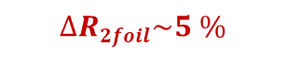
Comparison of total rate of detection
for different endcap foil configuration and different source holder
Endcap foil : 6F6F - 130 nm thick
Be coating - 120 nm thick
Source holder :
Mylar : 0.5 micron
6f6f : 120 nm
# : 20 Million events, Threshold : 30 keV
$$∆R2foil\sim 5 \%$$
Fig : Geant4 simulations results for change in ratio of the total events detected in detector 1 to detector 2 for the different foil configurations placed in front of the detector 1 along the +z axis. We compare the results for different source holder made of Mylar of thickness 0.5 micron and sixFsixF of thickness 120 nm.
APS DNP 2023 R.Gupta 10
Notes:
Prctical std to reliability. Wll defined situation. Ratios closely related to point of interest.
Present sim result for source holder

Slide 24
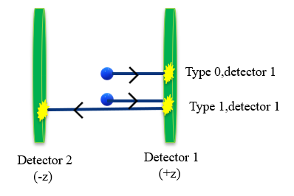
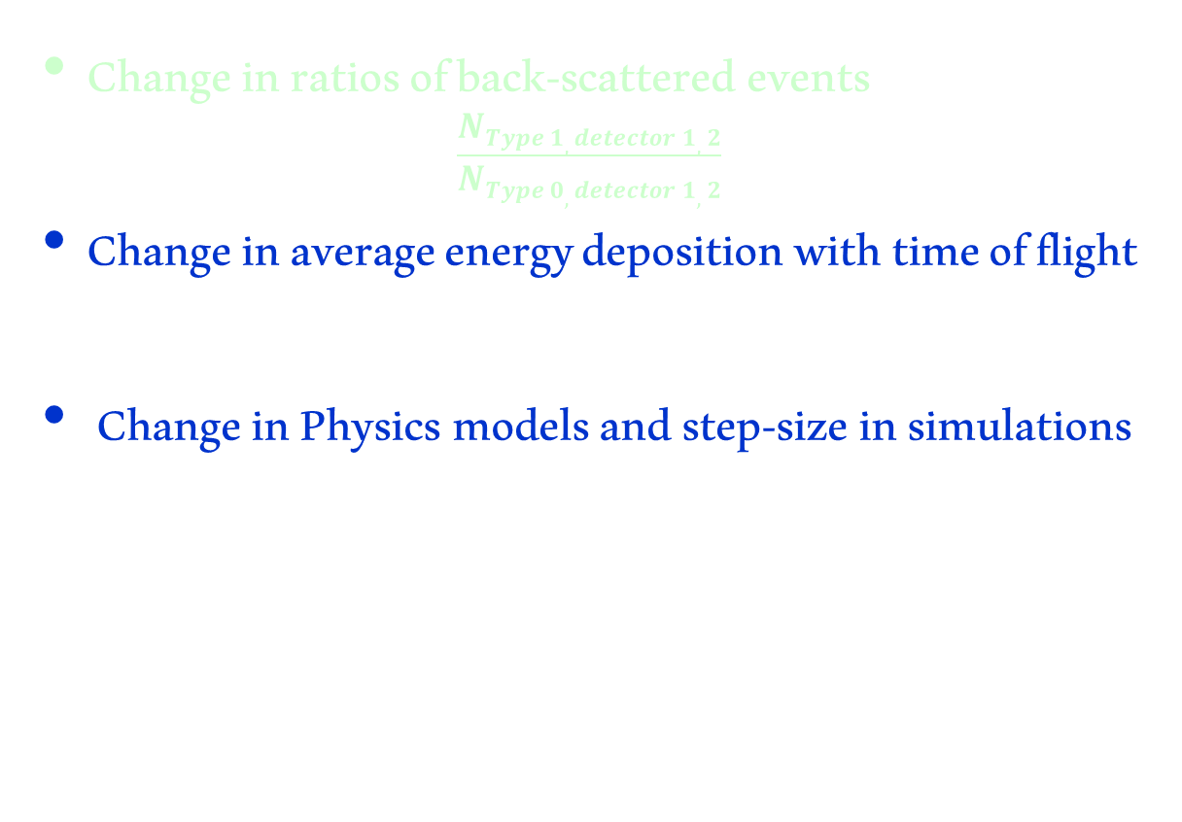
UCNA+ simulation results for backscattering systematics
Change in ratios of back-scattered events
$$\frac{NType 1, detector 1,2}{NType 0, detector 1,2}$$
Change in average energy deposition with time of flight
Change in Physics models and step-size in simulations
APS DNP 2023 R.Gupta 9

Slide 25
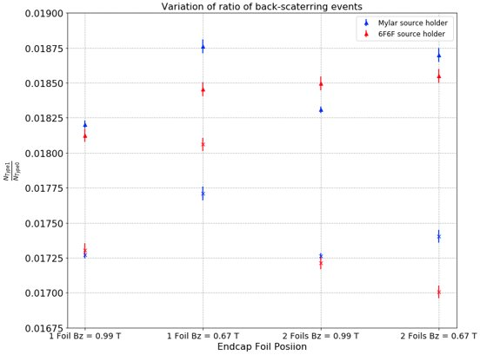
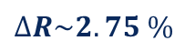
Comparison of change in ratios when foil is moved across B_{z}
for different endcap foil configuration and Mylar source holder
$$∆R\sim 2.75 \%$$
Near detector
Endcap foil : 6F6F - 130 nm thick
Be coating - 120 nm thick
Source holder :
Mylar : 0.5 micron
6f6f : 120 nm
# : 20 Million events, Threshold : 30 keV
Near decay trap
R =
Fig : Geant4 simulations results for change in ratio of the back-scattered events to the direct events for the different foil configurations placed in front of the detector 1 along the +z axis. We compare the results for different source holder made of Mylar of thickness 0.5 micron and sixFsixF of thickness 120 nm.
APS DNP 2023 R.Gupta 11

Slide 26
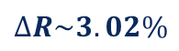
Comparison of change in ratios
for different endcap foil configuration and Mylar source holder
$$∆R\sim 3.02\%$$
Near detector
Endcap foil : 6F6F - 130 nm thick
Be coating - 120 nm thick
Source holder :
Mylar : 0.5 micron
6f6f : 120 nm
# : 20 Million events, Threshold : 30 keV
Near decay trap
Fig : Geant4 simulations results for change in ratio of the back-scattered events to the direct events for the different foil configurations placed in front of the detector 1 along the +z axis. We compare the results for different source holder made of Mylar of thickness 0.5 micron and sixFsixF of thickness 120 nm.
APS DNP 2023 R.Gupta 11

Slide 27
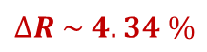
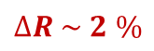
Comparison of change in ratios
for different endcap foil configuration and different source holder
$$∆R \sim 2 \%$$
Endcap foil : 6F6F - 130 nm thick
Be coating - 120 nm thick
Source holder :
Mylar : 0.5 micron
6f6f : 120 nm
# : 20 Million events, Threshold : 30 keV
$$∆R \sim 4.34 \%$$
Fig : Geant4 simulations results for change in ratio of the back-scattered events to the direct events for the different foil configurations placed in front of the detector 1 along the +z axis. We compare the results for different source holder made of Mylar of thickness 0.5 micron and sixFsixF of thickness 120 nm.
APS DNP 2023 R.Gupta 11

Slide 28
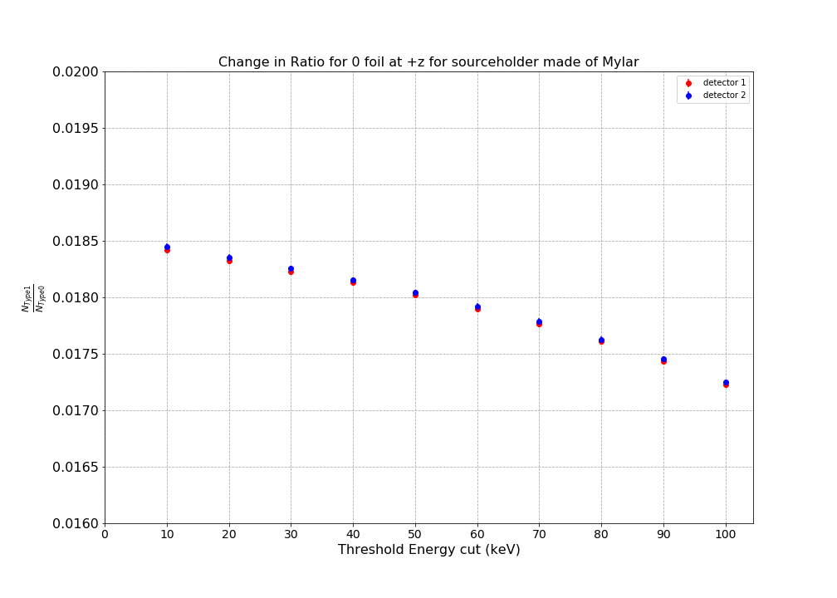
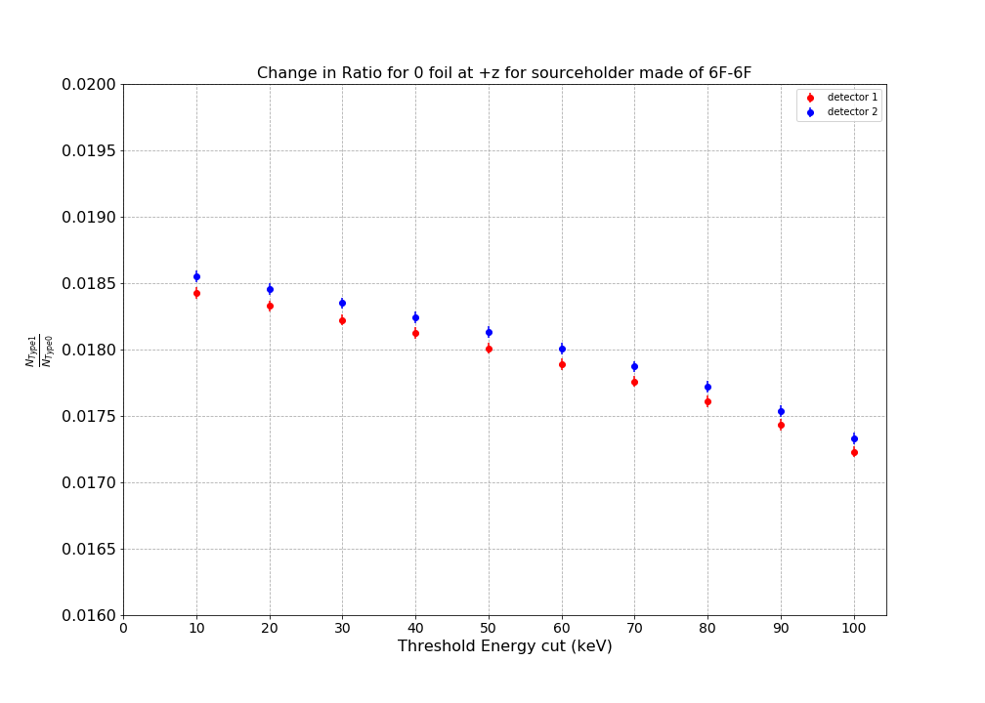
Threshold dependence
for different endcap foil configuration with different threshold values (0-100keV)
Fig : Geant4 simulations results for change in ratio of the back-scattered events to the direct events for the different foil configurations placed in front of the detector 1 along the +z axis for different detector threshold values. We compare the results for different source holder made of Mylar of thickness 0.5 micron and sixFsixF of thickness 120 nm as function of detector threshold
APS April 2023 R.Gupta 12
Notes:
If I were to display it as function of threshold. We see a good shift too from 0-1-2 fils. Which could possibly give us the threshod function for the detecor

Slide 29
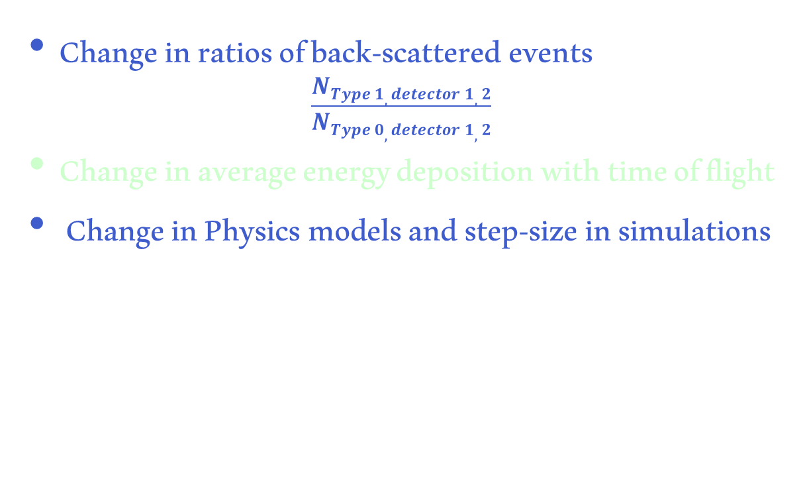
UCNA+ simulation results for backscattering systematics
Change in ratios of back-scattered events
$$\frac{NType 1, detector 1,2}{NType 0, detector 1,2}$$
Change in average energy deposition with time of flight
Change in Physics models and step-size in simulations

Slide 30
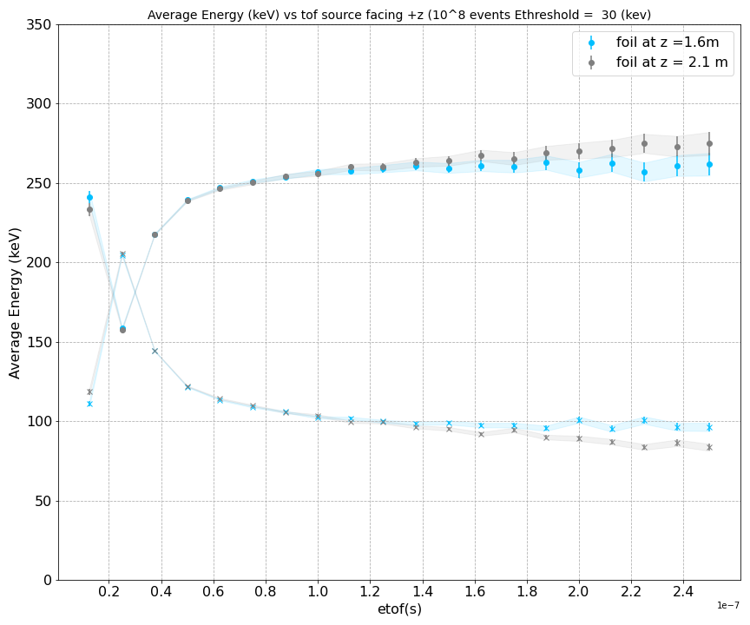
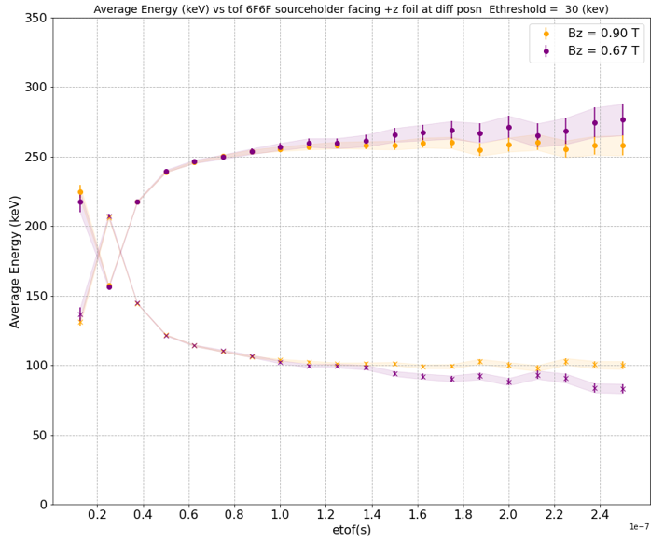
Comparison of change in E_{avg} in the detector with time of flight
for different endcap foil moved in field expansion region and different source holder
E_{avg} deposited in detector 1 (triggered first) increases with increase in time of flight from 25 ns – 125 ns and becomes ~ constant after that.
E_avg deposited in detector 2 at (-z) decreases when foil is moved from uniform to field expansion region
Detector 1
Detector 1
Detector 2
Detector 2
Fig : Geant4 simulations results for change E_{avg} detector with the time of flight for the back-scattered events that hit the detector 1 first . The analysis is done for the endcap foil configurations placed in front of the detector 1 along the +z axis andmoved through magnetic field expansion region.. We compare the results for different source holder made of Mylar of thickness 0.5 micron and sixFsixF of thickness 120 nm.
APS DNP 2023 R.Gupta 13
Notes:
check asymmetry angular distribution effects using foil in the field expansion region

Slide 31
Comparison of change in E_{avg} in the detector with time of flight
for different endcap foil moved in field expansion region and different source holder
E_{avg} deposited in detector 1 (triggered first) increases with increase in time of flight from 25 ns – 125 ns and becomes ~ constant after that.
E_avg deposited in detector 2 at (-z) decreases when foil is moved from uniform to field expansion region
Detector 1
Detector 1
Near decay trap
Detector 2
Detector 2
Near detector
Fig : Geant4 simulations results for change E_{avg} detector with the time of flight for the back-scattered events that hit the detector 1 first . The analysis is done for the endcap foil configurations placed in front of the detector 1 along the +z axis andmoved through magnetic field expansion region.. We compare the results for different source holder made of Mylar of thickness 0.5 micron and sixFsixF of thickness 120 nm.
APS DNP 2023 R.Gupta 13

Slide 32
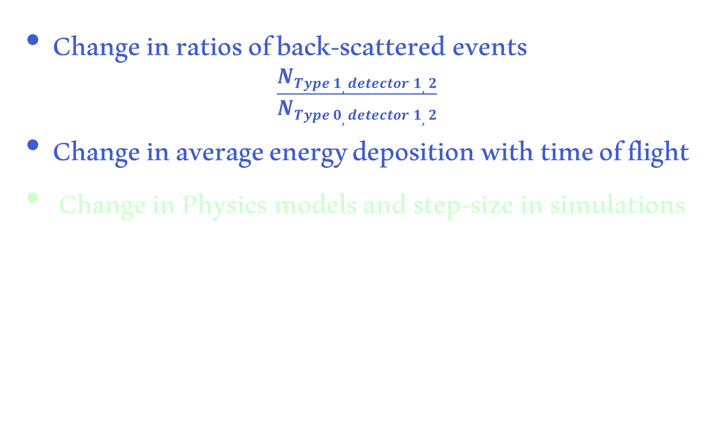
UCNA+ simulation results for backscattering systematics
Change in ratios of back-scattered events
$$\frac{NType 1, detector 1,2}{NType 0, detector 1,2}$$
Change in average energy deposition with time of flight
Change in Physics models and step-size in simulations

Slide 33
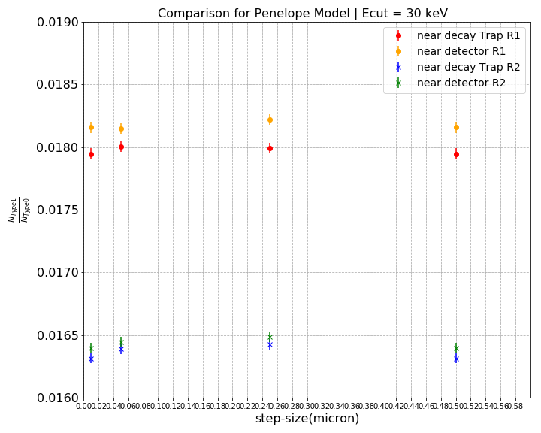
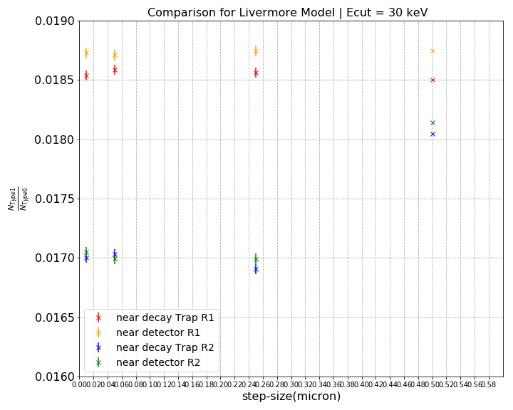
Comparison of Physics Models
for Mylar as source holder when Endcap foil is moved through magnetic field expansion region
The ratio changes by 7% on using different physics model.
Vary the step-size from the order of thickness of source-holder to thickness of dead-layer.
Fig : Geant4 simulations results for change in ratio of the back-scattered events to the direct events for different foil configurations when moved along the field expansion region placed in front of the detector 1 along the +z axis. We compare the results for Livermore and Penelope physics model as a function of step-size varied from 10 nm to 0.5 micron .
APS DNP 2023 R.Gupta 14
Notes:
we see different step size and see its impact in the backscattrering. Be freducing the step size in the simulation from that of the length of the source holder to the thickness of the endcap foil/dead layer. To see its impact. Not much of difference is observed. It is about ! 8.8% for diff step size. 2.when foil is near he decay trap the percentage diff btwn livermore and penelop mpdel is ~ 3% and this 5 decreases slightly with increase in the step size but not enough within the realm of the error bars. Which on combining will be ~7% effect in total. ? 3. compared to the avg value of 1.8% of back-scattered the difference is much more pronouced in the livermore model than the penelope model 4 times more.
---n order to better estimate the systematic uncertainty in this extrapolation, simulations were performed using GEANT4 and Penelope
---the Penelope simulation tends to better describe the angular distribution (aside from the overall scale factor). The GEANT4 distributions are somewhat narrower compared to the data and Penelope. Additionally, the GEANT4 simulation gives systematically larger backscattering from each material than does the Penelope simulation

Slide 34
CONCLUSION
Examine ratios of back-scattered events to direct events closely related to point of interest.
Present change in ratios for different configurations.
Discover the dependence on foil position in magnetic field expansion region and produce observable that can be less than 8 %
Physics models impacts the precision. Model correction needs to be considered
FUTURE WORK
Establish model reliability for UCNA+
Explore the dependence due to lower energy source
Understand the scattering cross-sections for different models.
Compare and plan to perform the measurements using foils from original experiment.
This material is based upon work supported by the U.S. Department of Energy, Office of Science, Office of Nuclear Physics, under Award Number DE-SC0 014622
APS DNP 2023 R.Gupta 15
Notes:
Conclusion:
situation. Ratios closely related to point of interest.
Present sim result for source holder
Mis back scatter geometry forfinal ucna was 0.18 with uncert 25 % assigned fro worst case scen
Presesnt bs rati fr sourc hand endcap foil configs
Note – plastic scint, no mwpc
4. mis-scatter correction for ucna geore(not)
5. Discover hat dependence of bs ratio on foil thickness position in Bz and soure holders cproduce cleafrly obsv qts can be 8% uncert.
…. Physics models impacts the precision at level must be taken not consider…. when considering model xorrectioni .
Working toward R&D in ucnaspec using foils from og ext to establish the model reliability.
- physics model. Need to look at lower energy source diff source energy.
. Analyze changes in particle dynamics when the endcap foil is moved across the magnetic field expansion region, comparing single foil to two foils.
Utilize diverse physics models and varying step sizes in simulations to understand and quantify observed phenomena, including energy deposition over time of flight.

Slide 35
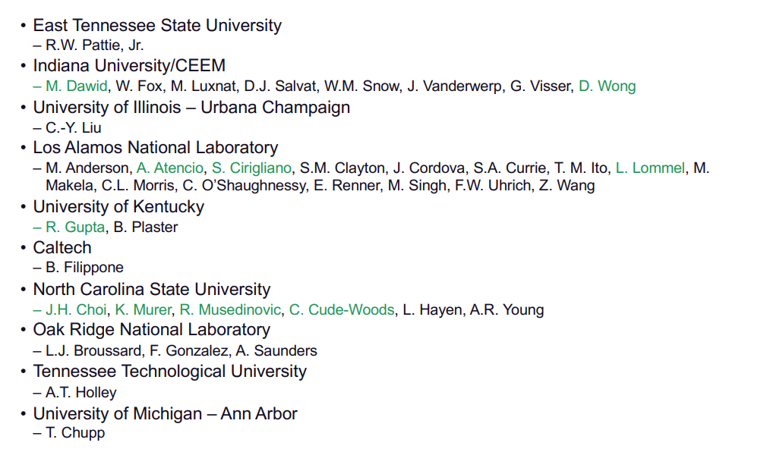
Collaboration

Slide 36
THANK YOU

Slide 37
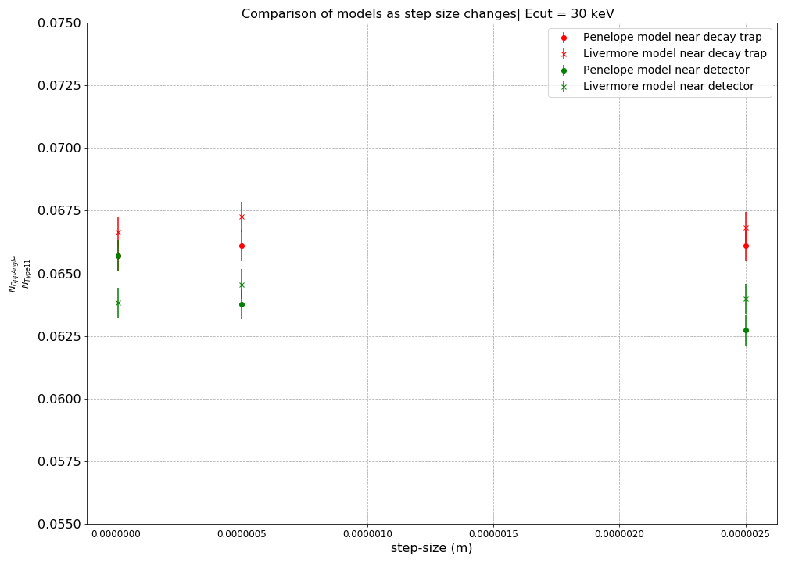
Ratio of particles emitted in opposite direction but detected by detector 1 (+z) first
Notes:
We also try to see the impact of the step size 6.6% of 1.8% of events that hit the detector 1 first were actually emitted in the opposite direction. It matches for Livermore model too. However we see differences when the foiol is near the detector. The number is less.

Slide 38
N02 inc, N01 n11 inc
N011 inc ~N11 N02 dec
N01 n11 dec
Notes:
Threshold of 30 keV
Whenever the source emits the electron it traverses and could see two objects before it gets detected- the source holder, and endcap foil. The e could backscatter endcap foil and hit detector 2 increasing N02 or ,it could help in trapping the e- between the endcap foil and detector. Getting more e in det1 . This either increases N01 or N11. However, this would be certainly less when the endcap foil is on the extreme end. E also sees the source foil if emitted in the opposite direction for the mylar source holder with larger thickness compared to 6F6F , e would be backscattered more and could increase the N11.

Slide 39
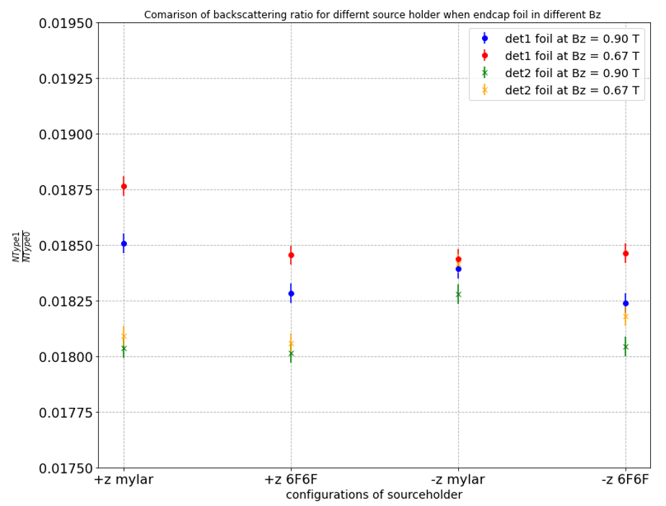
Notes:
Threshold of 30 keV
Threshold of 30 keV
We see that with the thickness of sourc e holder more there is more backscattering comoared to 6f6df even when the emission direction is reversed, for –z only we can see that r2 for 6 is less than that of mylar implying more backscattering by thicker source than 6f6f

Slide 40

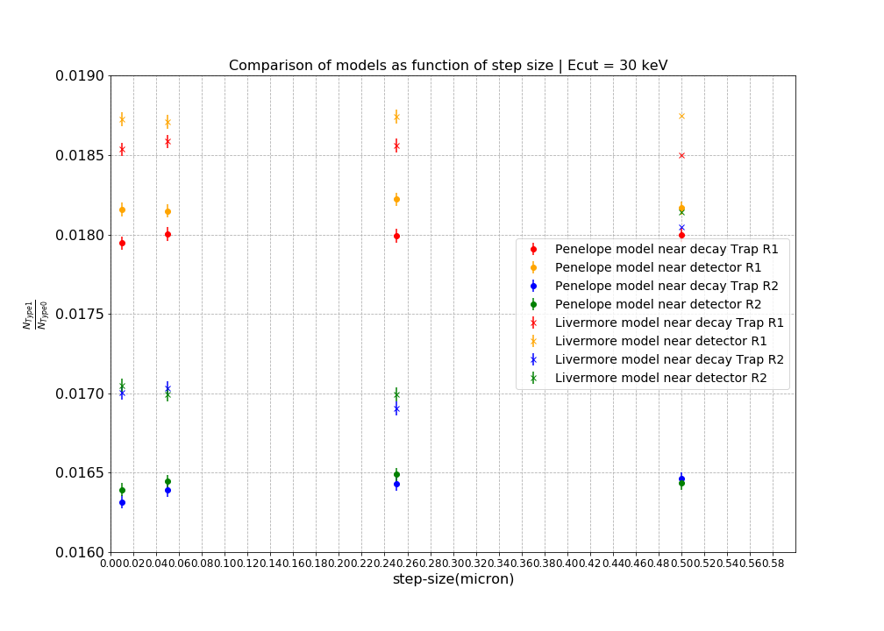
The change is ~ 7%
when foils moved to the extreme positions for detector 1
The ratio estimated ~ 9%
different compared to detector 2

Slide 41

UCNA + Geant4 setup
Fig : Geant4 simulations representation for base setup of UCNA+ experiment
APS DNP 2023 R.Gupta 7

Slide 42



Comparison of change in ratios
for different source holder (emitting e- in opposite directions) when Endcap foil is moved along B_{z}
The ratio is 1.3 % more for when e- hits detector 1 (at +z) when endcap foil is in uniform field expansion region.
decreases by 1.4 % when source- holder thickness decreases
Fig : Geant4 simulations results for change in ratio of the back-scattered events to the direct events for different foil configurations when moved along the field expansion region placed in front of the detector 1 along the +z axis. We compare the results for different source holder made of Mylar of thickness 0.5 micron and sixFsixF of thickness 120 nm emitting beta e- in forward direction (+z) and backward direction(-z).
APS DNP 2023 R.Gupta 11

Slide 43
Comparison of change in ratios
for different source holder (emitting e- in opposite directions) when Endcap foil is moved along B_{z}
The ratio is 1.3 % more for when e- hits detector 1 (at +z) when endcap foil is in uniform field expansion region.
decreases by 1.4 % when source- holder thickness decreases
Fig : Geant4 simulations results for change in ratio of the back-scattered events to the direct events for different foil configurations when moved along the field expansion region placed in front of the detector 1 along the +z axis. We compare the results for different source holder made of Mylar of thickness 0.5 micron and sixFsixF of thickness 120 nm emitting beta e- in forward direction (+z) and backward direction(-z).
APS DNP 2023 R.Gupta 11

Slide 44
Comparison of change in ratios
for different source holder (emitting e- in opposite directions) when Endcap foil is moved along B_{z}
The ratio is 1.3 % more for when e- hits detector 1 (at +z) when endcap foil is in uniform field expansion region.
decreases by 1.4 % when source- holder thickness decreases
Fig : Geant4 simulations results for change in ratio of the back-scattered events to the direct events for different foil configurations when moved along the field expansion region placed in front of the detector 1 along the +z axis. We compare the results for different source holder made of Mylar of thickness 0.5 micron and sixFsixF of thickness 120 nm emitting beta e- in forward direction (+z) and backward direction(-z).
APS DNP 2023 R.Gupta 11

Slide 45

Comparison of change in ratios
for source holder – 6f6f and when Endcap foil is moved through magnetic field expansion region
Fig : Geant4 simulations results for change in ratio of the back-scattered events to the direct events for different foil configurations when moved along the field expansion region placed in front of the detector 1 along the +z axis. We compare the results for different source holder made of Mylar of thickness 0.5 micron and sixFsixF of thickness 120 nm emitting beta e- in forward direction (+z) and backward direction(-z).
APS DNP 2023 R.Gupta 12

Slide 46
Comparison of change in ratios – 6f6f
for different source holder and when Endcap foil is moved through magnetic field expansion region
Fig : Geant4 simulations results for change in ratio of the back-scattered events to the direct events for different foil configurations when moved along the field expansion region placed in front of the detector 1 along the +z axis. We compare the results for different source holder made of Mylar of thickness 0.5 micron and sixFsixF of thickness 120 nm emitting beta e- in forward direction (+z) and backward direction(-z).
APS DNP 2023 R.Gupta 12

Slide 47
Comparison of change in ratios - mylar source holder
for different source holder and when Endcap foil is moved through magnetic field expansion region
Fig : Geant4 simulations results for change in ratio of the back-scattered events to the direct events for different foil configurations when moved along the field expansion region placed in front of the detector 1 along the +z axis. We compare the results for different source holder made of Mylar of thickness 0.5 micron and sixFsixF of thickness 120 nm emitting beta e- in forward direction (+z) and backward direction(-z).
APS DNP 2023 R.Gupta 12

Slide 48
Comparison of change in ratios – mylar source holder
for different source holder and when Endcap foil is moved through magnetic field expansion region
Fig : Geant4 simulations results for change in ratio of the back-scattered events to the direct events for different foil configurations when moved along the field expansion region placed in front of the detector 1 along the +z axis. We compare the results for different source holder made of Mylar of thickness 0.5 micron and sixFsixF of thickness 120 nm emitting beta e- in forward direction (+z) and backward direction(-z).
APS DNP 2023 R.Gupta 12

Slide 49
Comparison of change in ratios
for different endcap foil configuration and Mylar source holder
Endcap foil : 6F6F - 130 nm thick
Be coating - 120 nm thick
Source holder :
Mylar : 0.5 micron
6f6f : 120 nm
# : 20 Million events, Threshold : 30 keV
Fig : Geant4 simulations results for change in ratio of the back-scattered events to the direct events for the different foil configurations placed in front of the detector 1 along the +z axis. We compare the results for different source holder made of Mylar of thickness 0.5 micron and sixFsixF of thickness 120 nm.
APS DNP 2023 R.Gupta 10

